Slide 1
Transforming Apps

Slide 2
Front End Development Process
Analysis
Need for Migration
Current Infrastructure
Design
UX designs and graphics
Technology Integration
Production Deployment
Roll Out
Front End Development
Requirement Document
Wireframe designs
Design document with new System Architecture and integration points.
Backend/Webservice Development
Integration
Testing
Business performing User Acceptance Testing
Post-Production Support
Identify Re-usability
Training
Train the business users for the new UI
Define technology stack.
Define tools to be used
Bug Fixing
Deployment of the app on UAT setup

Slide 3
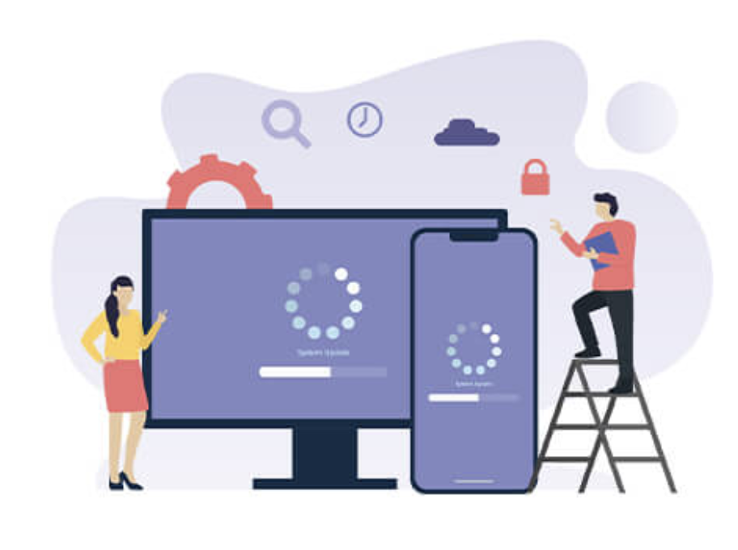
Top 7 Points to consider when upgrading from Legacy Web App
Responsive Design
Legacy Apps
Responsive Web Apps
Modular equals modernized
Integrate tightly with DevOps
Build security into applications
Create context to reduce costs
Unshackle applications from infrastructure
Break down the monolith

Slide 4
Front End Development Approach
Legacy App(ASP/JSP Pages etc)
User Interface
Middleware
Understand existing Website/Portal
Suggest New Enhancements
Identify Re-usable Code
Code Improvement Changes
Develop/Modify Webservices
Backend Integration
New UI Wireframes/Design
Deployment
CI/CD Build Process
Identify UI screens and application flow
Identify UI validations and UI specific logic.
Suggest new UI framework if the existing one is old and has no support.
Create Wireframes
UI Prototyping
Create UI Style Guides
Check availability of webapi code
Identify any business logic to be maintained
Identify inline queries which can be enhanced.
Migrate inline queries to stored procedures
Ensure the code is loosely coupled
Define and create new webservices/ webapi required for the new UI.
Integrate with different existing/new backend systems for Authentication, Content Management Systems etc.
Whole Build and Deployment process need to be automated using some latest deployment tool.

Slide 5
Decoupling Backend and Frontend
Understand the existing legacy app
Identify the UI and backend components to be decoupled
Create UX designs
Create the responsive UI to support multiple browsers.
Create Webservice Layer connecting to the legacy backend and exposing REST based services for the new UI
Create a list of Data base dependencies
Created a list on what can be moved to reference DB like Mongo.

Slide 6
Upgrading/Migrating existing Frontend
This involves migrating from existing JavaScript outdated framework to the latest framework
Understand the existing Web app/portal
Identify the components which can be re-used in the existing framework.
Create the responsive UI to support multiple browsers.
Create a list on if any existing business logic that can be reused.

